Slide 1
CI/ CD PIPELINE PROCESSES

Slide 2
Jenkins
Jenkins is a tool that is used for automation
It is mainly an open-source server that allows all the developers to build, test and deploy software.
Jenkins facilitates the automation of several stages of the software development lifecycle, including application development, testing, and deployment.
Continuous delivery (CD) and integration (CI) pipelines can be created and managed with Jenkins.
The development, testing, and deployment of software applications are automated using CI/CD pipelines

Slide 3
CI/ CD
Jenkins CI/CD stands for Continuous Integration/ Continuous Development
In computing, a pipeline is a set of stages or processes linked together to form a processing systemDDWIiejf9e dweffefy8uwg ffhwugt. Each stage in the pipeline takes an input, processes it in accordance with a set of rules, and then sends the outputs to the stage that follows.
Frequently, the pipeline’s overall output is its final step’s output. like the procedures outlined below
Test code, Build Application, PusWYDH EB26E2JBE22RRRHIQh Repository, Deploy to Server
All the stepss mentioned above will perform in sequence one after the other if any step/stage get failed it will not move forward to another step/stage until the previous step got a success.chy bjehhyy6 yft2getvg dad hefgeufgf ;;ef 8efgef.sgtfb/hiofjfjhhhhhhhhhi77777 [[[un

Slide 4
PIPELINE
DevOps professionals mostly work with pipelines because pipelines can automate the processes like building, testing, and deploying the application.
With the help of Continuous Integration / Continuous Deployment (CI/CD) Pipeline scripts we can automate the whole process which will increase productivity and save lots of time for the organization and can deliver quality applications to the end users.
Jenkins Pipeline can be defined by a text file called JenkinsFile. You can implement pipeline as code using JenkinsFile, and this can be defined by using a DSL (Domain Specific Language). With the help of JenkinsFile, you can write the steps required for running a Jenkins Pipeline.

Slide 5
Pipeline process
Steps, to build a basic pipeline in Jenkins--
Login to the Jenkins account.
Once logged in the user will be directed to the Jenkins console.(For the reference have a look at the next slide)
To build a pipeline necessary plugins need to be installed and tools to added, if necessary few credentials need to added which help to build the pipeline.
Pipeline script which is written in java helps to build the pipeline egb 7de geigLKWUY EIUFFHE IFN F
EIFUH YFH; 8O YEHIF7UEF BIKIFHHFHUFJFHYFHFF
FH8IEJFGIUHF
LE8FYHHFHYFFFEIKJEFB,.KSDHO8IFJBVHDJFIHFGLEF
E;LF 8EIKFVBLF
F9IKEFJBNFJ.LLLA\
JCHUGBBCGHCGJKSU7HSJCGC
FLY8JEFGWEKIWG.;W;.JW FE
GK8IJ;QAQKQI iNH yf gyehfkikklsukdijhsudhegeldpkdud
Djdjndkdjudndbndid
Didndhd
Dlidmdhdjod

Slide 6
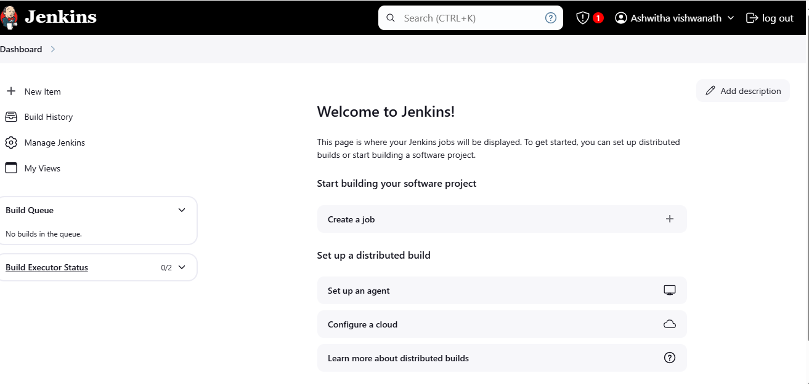

Slide 7
Pipeline process
Once logged in to the Jenkins console, install the necessary plugins for example eclipse temurin installer, SonarQube scanner, pipeline stage view…
Add the tools like jdk, maven, sonar scanner
The plugins which needs to installed and the tools that need to added can be seen in the manage Jenkins.
If necessary, add the credentials depends on the pipeline to be built
Then go the new item which can be seen in the console on left
Name the item and select or opt for the pipeline

Slide 8
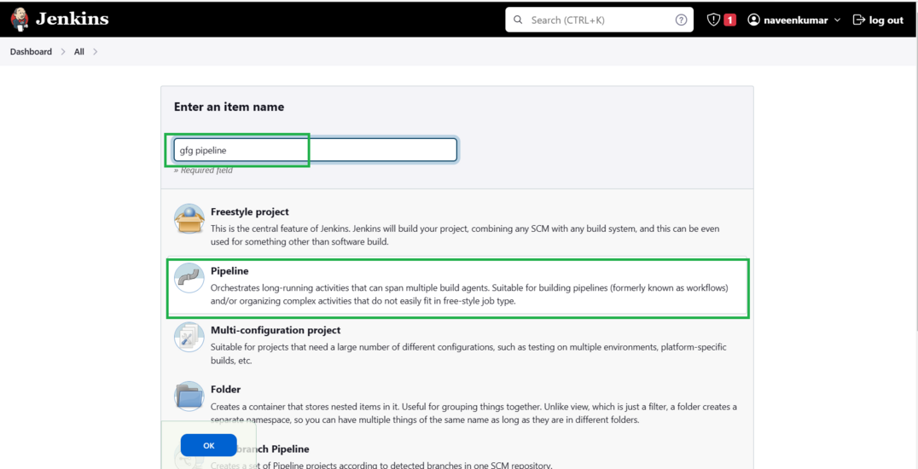

Slide 9
In the general provide the description.
And then provide the pipeline script.
Then apply and save the pipeline.
Then click on build now which is on left of the console.
The pipeline build shows success.
All the steps mentioned above will perform in sequence one after the other if any step/stage get failed it will not move forward to another step/stage until the previous step got a success.
The basic steps to build a CI/ CD pipeline.yf
In the clearifuication xvahguh ggdutkusw
Bgjds5fffsts00s26rfcsushshskh;I kjgduujhvf
Lkhyydgjhkidid u ibjf
Lhjbhdis
Nu ujsi isyshis
Slyslsuys
ljdbjhugjuusmdh

Slide 10
Pipeline script
pipeline{ agent any tools { jdk 'jdk17' maven 'maven3' } environment { SCANNER_HOME=tool 'sonar-scanner' } stages{ stage ('clean Workspace'){ steps{ cleanWs() } } stage ('checkout scm') { steps { git 'https://github.com/Venn1991/jpetstore-6.git' } } stage ('maven compile') { steps { sh 'mvn clean compile' } } stage ('maven Test') { steps { sh 'mvn test' } }
} }

Slide 11
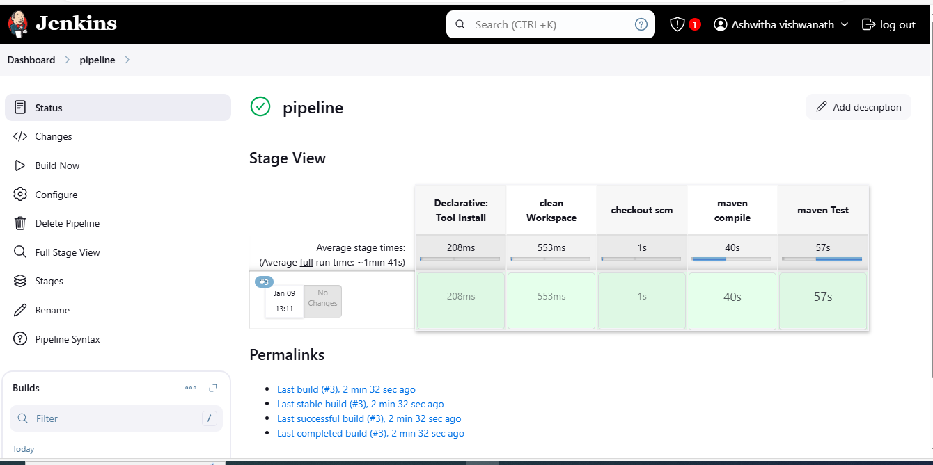

Slide 12
THANKYOU

